Slide 1

REGRESSION
By-
Saujanna Jafreen
Lecturer
Department of Natural Sciences

Slide 2
INTRODUCTION
The usual purpose of regression analysis is to explain and predict the changes in the magnitude of a given variable in terms of one or more variables.
The variable to be explained is called the dependent variable, usually denoted by y and the remaining variables are known as independent or explanatory variables usually denoted by x1,x2,……..,xn.
In regression analysis we express the relationship between the dependent variables and the independent variables by means of an equation.

Slide 3
APPLICATION
The regression equation provides a concise and meaningful summary of the relationship between y on x.
The relation can be used for predictive purposes.

Slide 4
INDEPENDENT AND DEPENDENT VARIABLE:
What's an independent variable?
Answer: An independent variable is exactly what it sounds like. It is a variable that stands alone and isn't changed by the other variables.
For example, someone's age might be an independent variable. Other factors (such as what they eat, how much they go to school, how much television they watch) aren't going to change a person's age.
What's a dependent variable?
Answer: Just like an independent variable, a dependent variable is exactly what it sounds like. It is something that depends on other factors.
For example, a test score could be a dependent variable because it could change depending on several factors such as how much you studied, how much sleep you got the night before you took the test, or even how hungry you were when you took it.

Slide 5
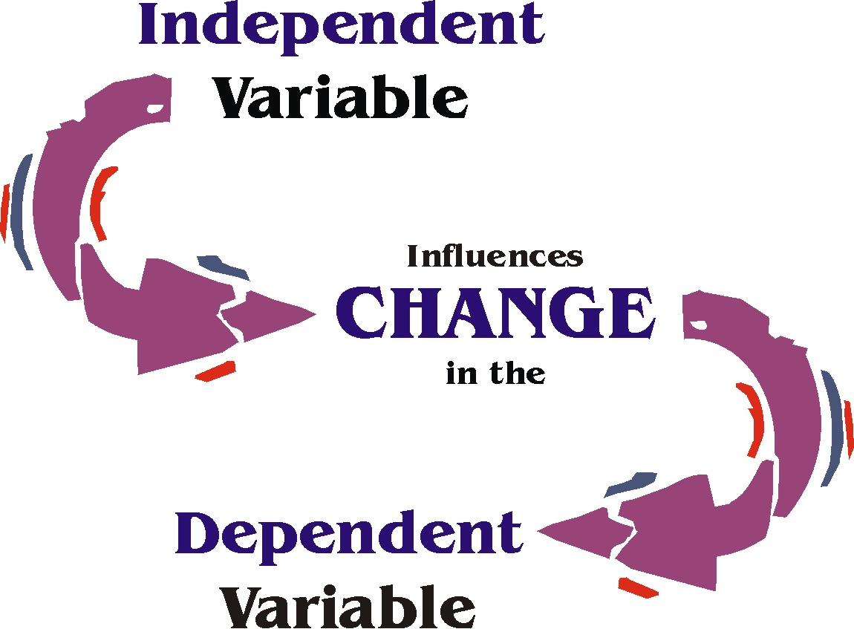

Slide 6
R-SQUARED
R-squared is a statistical measure of how close the data are to the fitted regression line. It is also known as the coefficient of determination, or the coefficient of multiple determination for multiple regression.
R-squared = Explained variation / Total variation
R-squared is always between 0 and 100%:or 0 to 1
0% or 0 indicates that, no linear relationship between the dependent variable and the independent variable.
100% or 1 indicates that all the observations fall on the regression line, that is independent and dependent variable are perfectly related.
In general, the higher the R-squared, the better the model fits your data.

Slide 7
INTERPRETATION:
R-squared= 0 ; regression line doesn’t fit the data
R-squared= 1 ; regression line perfectly fit the data
R-squared= 0.5 ; 50% of the variation in the dependent variable can be explained by the independent variable.

Slide 8
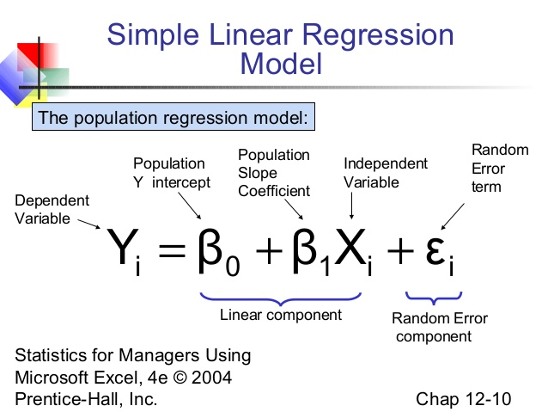

Slide 9


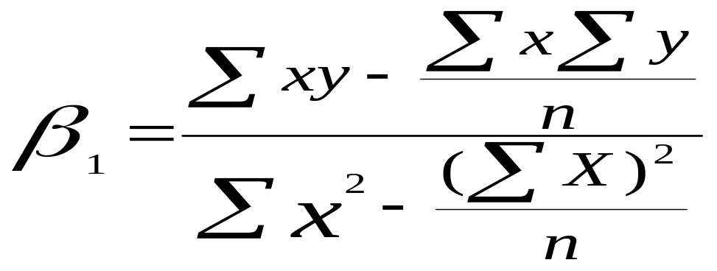
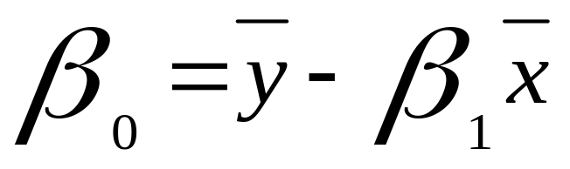
EQUATION
Regression equation can be defined as;
y= + x
where,

Slide 10
PROBLEM
Let us consider, the data on sales volume presented in table 1 .compute the least square regression model between the year of experience of the sales persons(X) and the annual sales volume (Y).

Slide 11
SOLUTION
Sales person | X | Y | XY | X2 | Y2
1 | 1 | 80 | 80 | 1 | 6400
2 | 3 | 97 | 291 | 9 | 9409
3 | 4 | 92 | 368 | 16 | 8464
4 | 4 | 102 | 408 | 16 | 10404
5 | 6 | 103 | 618 | 36 | 10609
6 | 8 | 111 | 888 | 64 | 12321
7 | 10 | 119 | 1190 | 100 | 14161
8 | 10 | 123 | 1230 | 100 | 15129
9 | 11 | 117 | 1287 | 121 | 13689
10 | 13 | 136 | 1768 | 169 | 18496
Totals | 70 | 1080 | 8128 | 632 | 119082

Slide 12
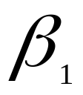
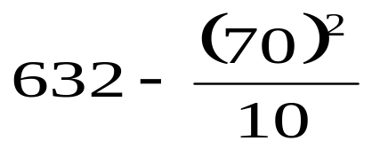

70 × 1080
8128 -
10
=
= 4
=108 - 4 × 7
=80
The estimated regression model is
Y=80+4x
If x= 15 then Y= 140

Slide 13



INTERPRETATION
refers that, if x=0 on an average the value of dependent variable is 80.
refers that, for each additional increase of independent variable can expect to increase the value of dependent variable is about 4.
When is positive , relationship between x and y is positive. That is if x increase than y increase.
When is negative , relationship between x and y is negative. That is if x increase than y decrease.

Slide 14
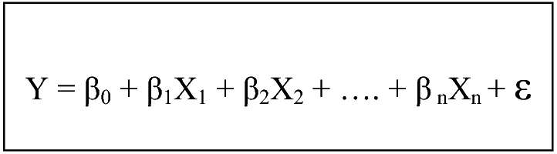
MULTIPLE REGRESSION MODEL

Slide 15
DISTINGUISH BETWEEN SIMPLE AND MULTIPLE REGRESSION
In simple linear regression a single independent variable is used to predict the value of a dependent variable.
In multiple linear regression two or more independent variables are used to predict the value of a dependent variable.
The difference between the two is the number of independent variables.

Slide 16
DIFFERENCE BETWEEN CORRELATION AND REGRESSION
 | Correlation | Regression
Define | In simple linear regression a single independent variable is used to predict the value of a dependent variable. | In regression we can predict the relationship between more than two variables
Co efficient | r | R
Range of co efficient | -1 to +1 | 0 to 1

Slide 17


